Slide 1




Customer Behavior Prediction Model Using RFM and Logistic Regression
Latifah Al-Rasheedi

Slide 2
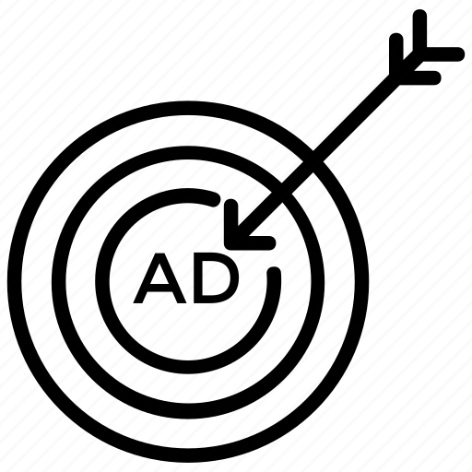
Bussiness Problem
Since marketing campaigns consume a lot of companies' resources, companies nowadays understand the importance of analyzing their customers' behavior and its impact on the campaign's success.
Therefore I decided to build a model that predicts the next purchase day of the customer, which will help companies prepare special offers to their customers based on their level.

Slide 3


Project steps
01
02
Data Cleaning
03
Feature Engineering
Find suitable dataset
04
Data Visualization
05
RFM method
06
Data Modeling

Slide 4
01
Data Describtion

Slide 5
The data used is an E-Commerce dataset from Kaggle, which contains actual transactions from UK retailers
Transactions period: | From 01/12/2010 to 09/12/2011
Number of features: | 8
Number of observations: | 541,908
Features data types: | Categorical: Invoice_Number , Stock_Code, Description, Invoice_Date, Country Numerical: Customer_ID ,Unit_Price, Quantity

Slide 6
02
Data Cleaning

Slide 7
Cleaning Process
Columns
Rows
Change data type:
invoice Date to date time type.
customer ID to integer type.
Make columns names lowercased.
Change ‘description’ to lower case.

Slide 8
Handling Null and duplicates
Null Values
Cancelled orders
Duplicated values
Description: 1454 Customer ID: 135080
Zero quantity = Cancelled orders
Drop
Drop
Number of duplicates: 5225
Drop

Slide 9
03
Feature Engineering

Slide 10
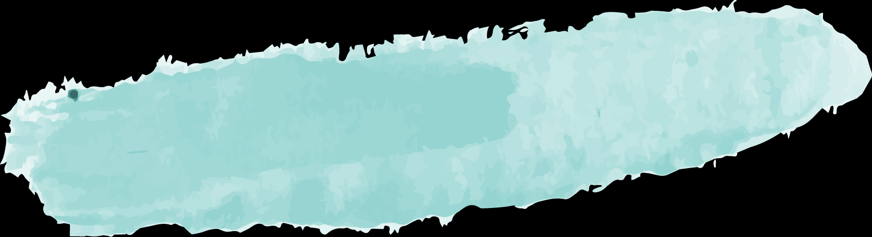
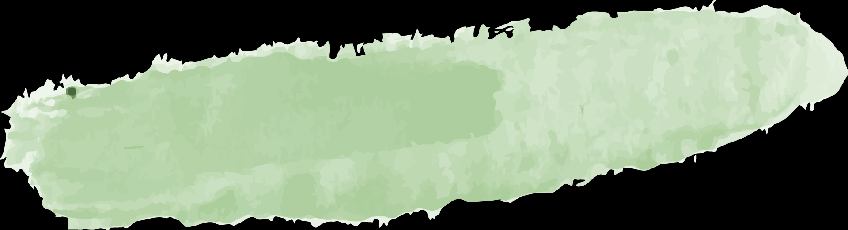
New Features added
Feature Splitting
Creating Features
Invoice_date
2010-12-01 08:26:00
Quantity X Unit_Price
Total spent
Invoice_date | year | month | day | hour
2010-12-01 08:26:00 | 2010 | 12 | 1 | 8

Slide 11
04
Data Visualization

Slide 12
Let’s answer some business questions

Slide 13
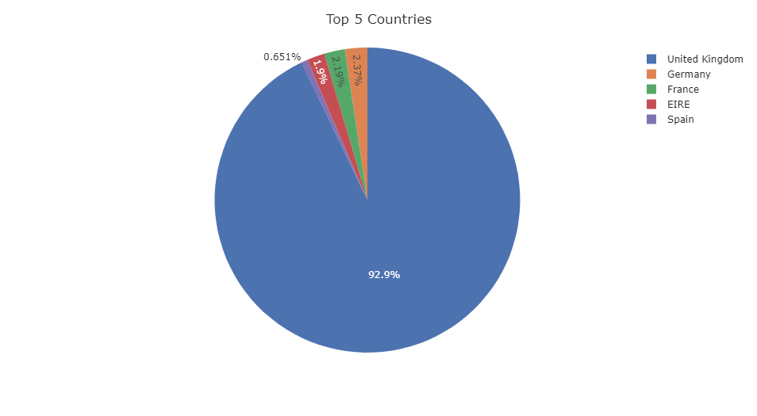
Which country with the highest number of customers?

Slide 14
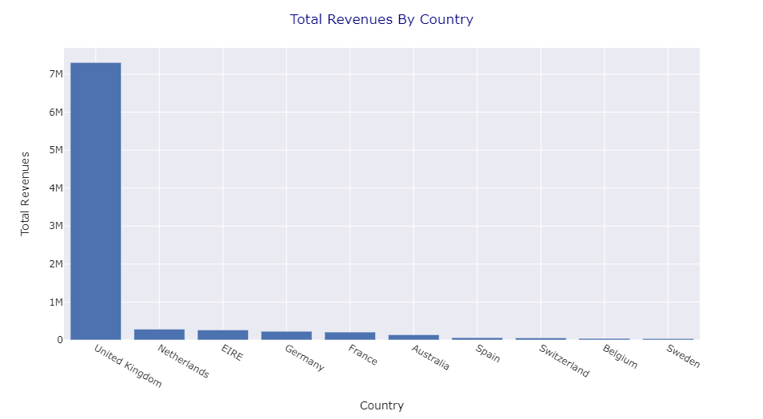
Which countries with the highest revenues?

Slide 15
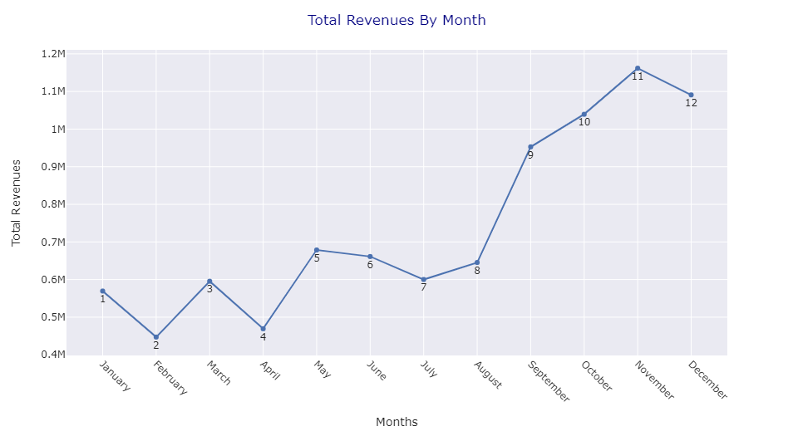
Which month ranked the highest revenues?

Slide 16
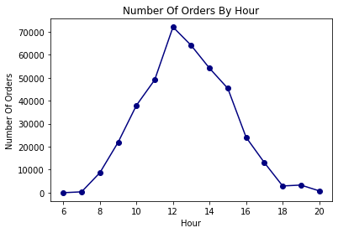
What time is the best for launching a new campaign/Advertisement?

Slide 17
05
RFM METHOD

Slide 18
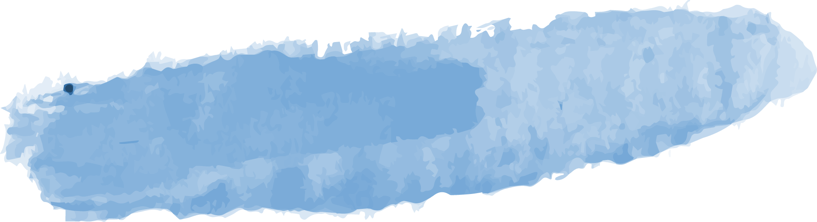
RFM (Recency, Frequency, Monetary) analysis
It is a customer segmentation technique that uses past purchase behavior to divide customers into groups!
RECENCY
Days since last purchase
FREQUENCY
Total number of purchases
MONETARY
Total money this customer spent

Slide 19
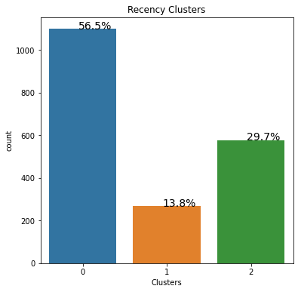
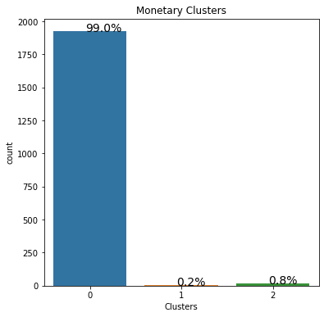
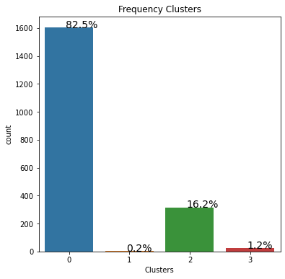
RFM Clusters
56% of the customers are active
99% of the customers spent the least
82% of the customers with few number of orders

Slide 20
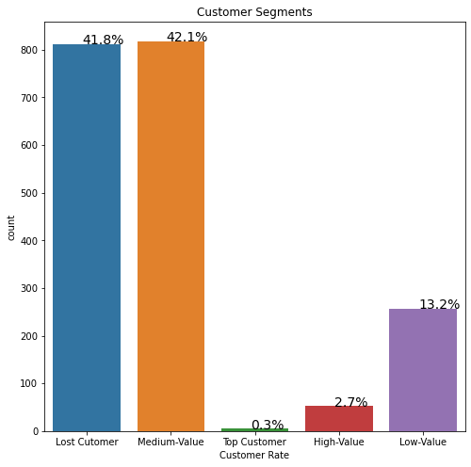
RFM Segmentation

Slide 21
06
Data Modeling

Slide 22
Models used
My target
Day Range: it 0 if a customer took more than 3 months to purchase. It 1 if customer purchased within 3 months.
Model | Accuracy
Logistic Regression | 88%
Random Forest | 88%
KNN | 75%

Slide 23
I chose logistic regression model, since it has the highest accuracy and F1-score!

Slide 24
Thank you!

